Slide 1
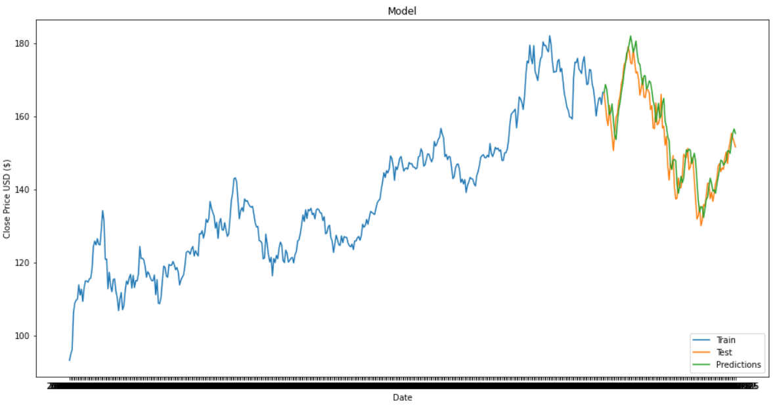
Forecasting Stock Price with Long Short Term Memory (LSTM) Network
Rui Cai, Wenyi Hu, Rao (Ryan) Lu, Nawaz Quraishi
July 29, 2022

Slide 2
Introduction to LSTM Algorithms
LSTM stands for Long Short Term Memory
Class of Recurrent Neural Networks (RNN)
LSTM is used because it is detects long term dependencies in the data
LSTMs remember information over long periods of time

Slide 3


Applications of LSTM
Speech Recognition
Sentiment Analysis
Image Recognition
Stock prediction

Slide 4
Popular Algorithms in the Industry
Autoregressive (AR)
Autoregressive Integrated Moving Average (ARIMA)
Seasonal Autoregressive Integrated Moving Average (SARIMA)
Exponential Smoothing (ES)

Slide 5
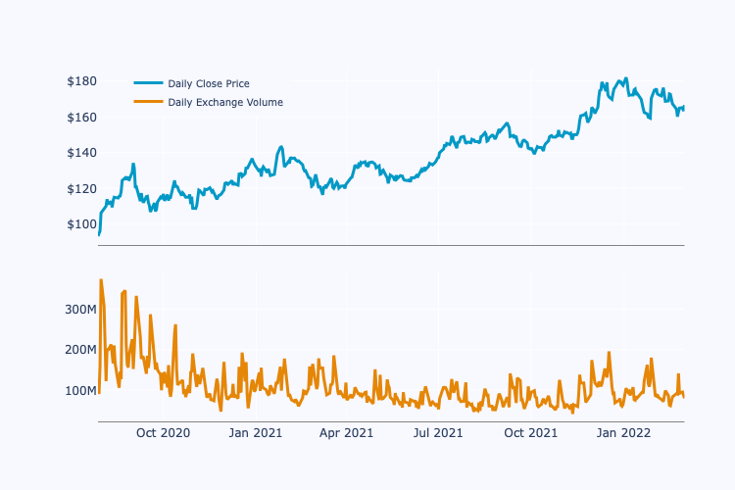
Dataset: Apple Daily Stock Price
Apple daily stock price July 27, 2020 to July 26, 2022
504 observations
Training data: Jul 27, 2020 - Mar 02, 2022
Test data: Mar 03, 2022 - Jul 26, 2022
Features:
Open price
High price
Low price
Close price
Adjusted price
Volume
New features:
Change in High price
Difference of same day Open and Close price
Difference of same day High and Low price

Slide 6
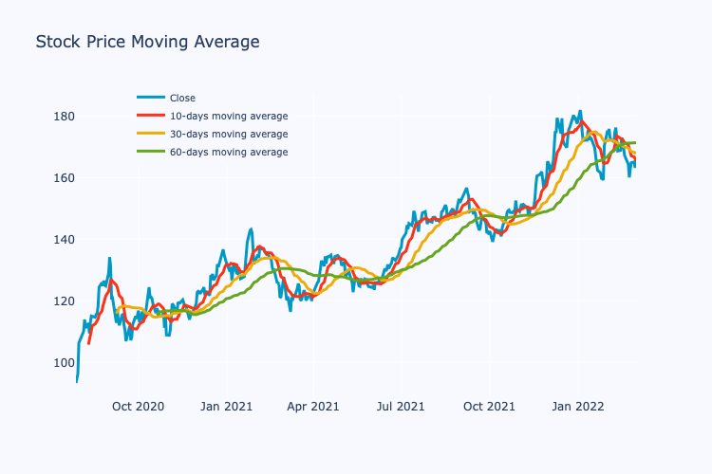
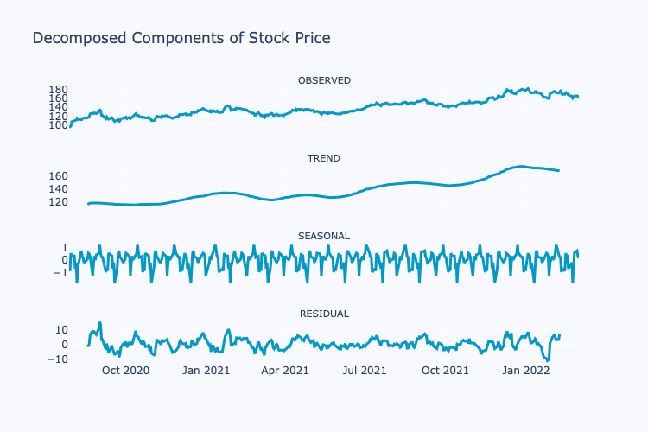
Dataset: Apple Daily Stock Price

Slide 7
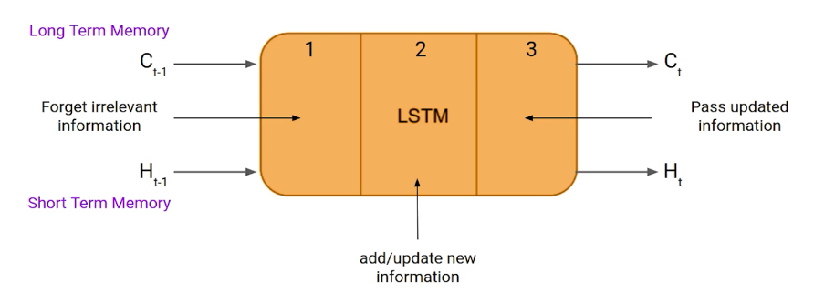
LSTM Implementation
Model Type
Univariate LSTM
Multivariate LSTM: Multiple input/parallel series
LSTM Components
Cell state (c_{t}) - stores short and long term memories
Hidden state (h_{t})
output state information
retrieve short or long-term or both types of memory stored in the cell state to make the next prediction.
Input gate (i_{t}) - current input flows to the cell state
Forget gate (f_{t}) - current input and the previous cell state flows into the current cell state
Output gate (o_{t})
current cell state flows into the hidden state
LSTM can pick either or both long/short memories

Slide 8
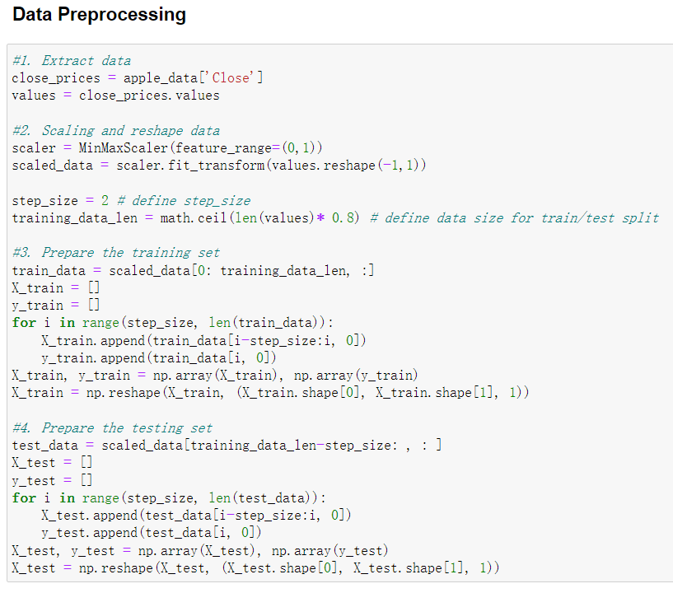
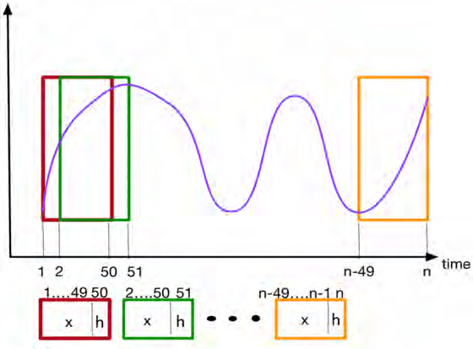
Modeling
Extract ‘Close’ data
Scaling and reshape data
Prepare train/test sets
Data Preprocessing

Slide 9
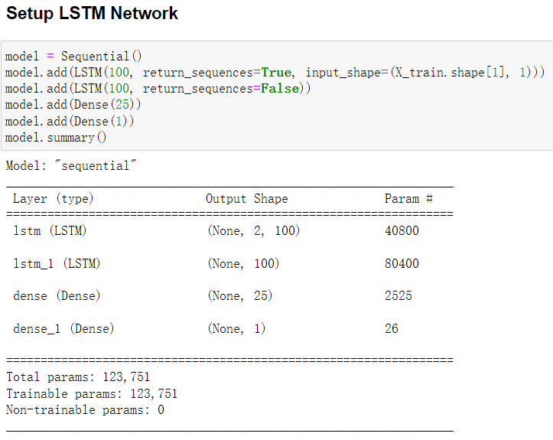
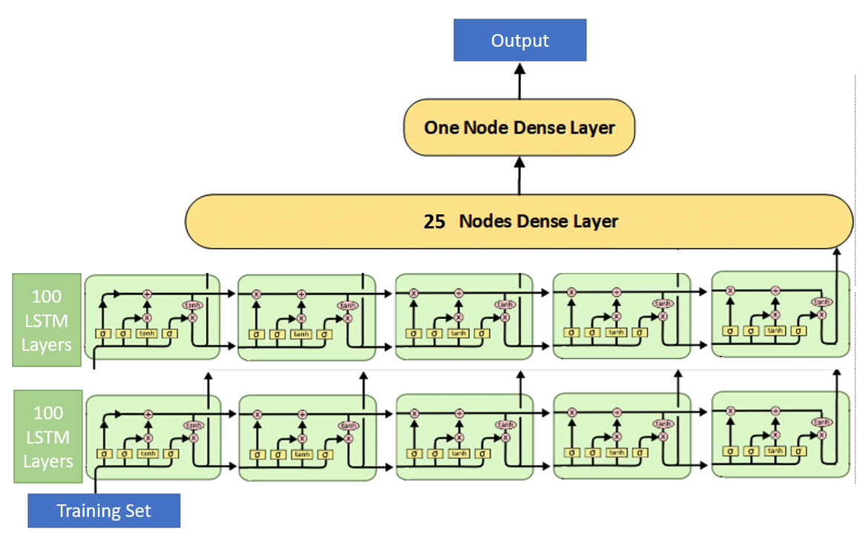
Modeling
Define Sequential model
Add LSTM layers
Add Dense layers
Data Preprocessing | Setup LSTM Network
Notes:
stack

Slide 10
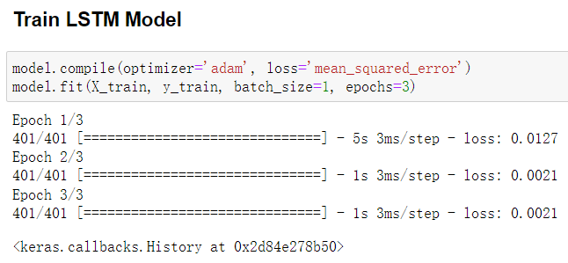
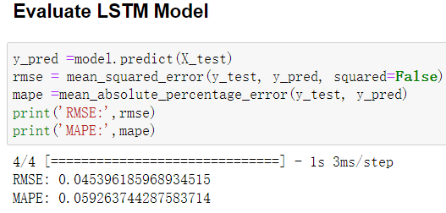
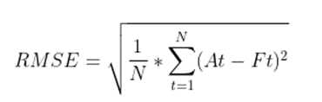
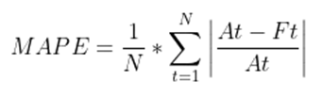
Modeling
Config the model
Train the model
Data Preprocessing | Setup LSTM Network | Train LSTM Model | Evaluate LSTM Model
Apply model to predict price
RMSE
MAPE

Slide 11
Modeling
Extract ‘Close’ data
Scaling and reshape data
Prepare train/test sets
Config the model
Train the model
Plot predicted vs real
Data Preprocessing | Setup LSTM Network | Train LSTM Model | Evaluate LSTM Model | Prediction Visualization
Define Sequential model
Add LSTM layers
Add Dense layers
Apply model to predict price
RMSE
MAPE

Slide 12
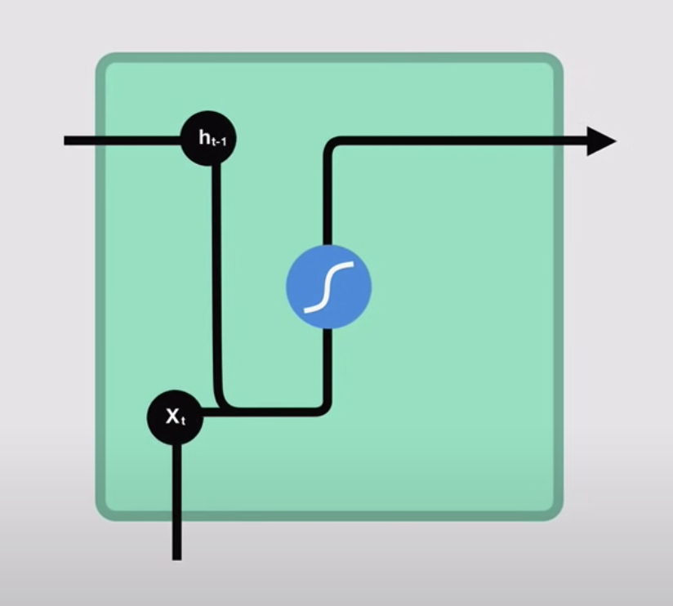
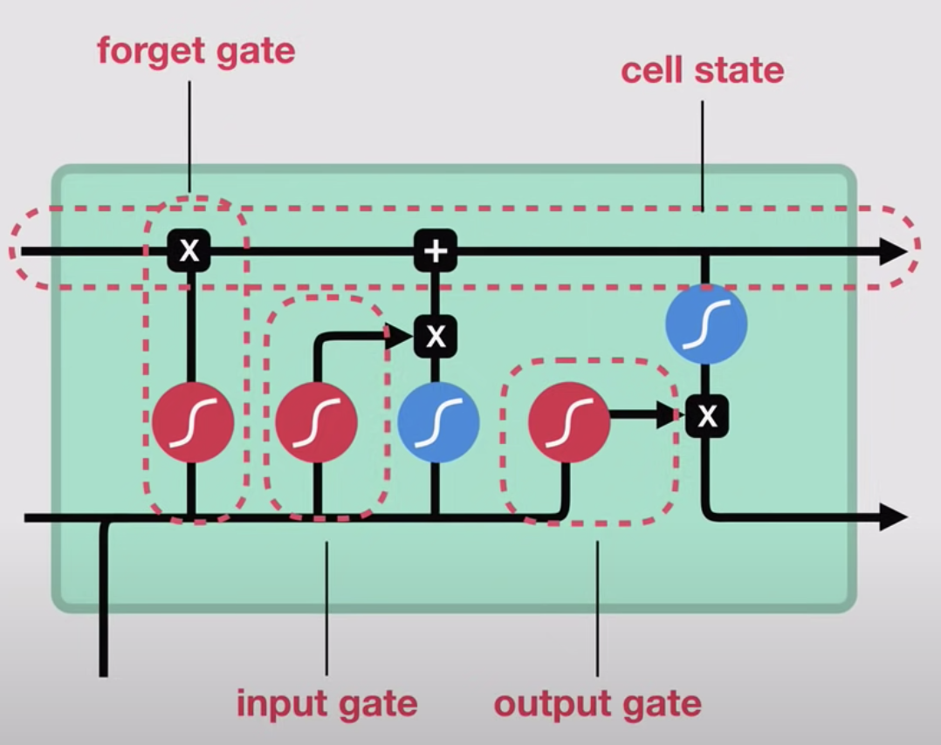
Pros and Cons of LSTM
Pros
Better memory
Solved vanishing gradient
New weight = weight - learning rate * gradient
Provide a large range of parameters, learning rate, input and output biases, no need for fine adjustment.
RNN cell
LSTM cell
Cons
Inefficient, requires high memory-bandwidth, time and resources in real world applications
Developers are looking to algorithms which remember information for a longer time as the evolve of technology

Slide 13
Summary and Future steps
Time Series
Facebook perform 4.5 billion automatic transaction a day using LSTM
LSTM was cited 16,000 times in 2021
Our Study:
Univariate model, 2 layer, 504 days, 2 time steps
Future Steps:
Multivariate model

Slide 14
Thank you!
Rui Cai, Wenyi Hu, Rao (Ryan) Lu, Nawaz Quraishi
July 29, 2022

Slide 15
Reference
https://medium.com/the-handbook-of-coding-in-finance/stock-prices-prediction-using-long-short-term-memory-lstm-model-in-python-734dd1ed6827
https://www.projectpro.io/article/stock-price-prediction-using-machine-learning-project/571#:~:text=FAQs-,Which%20machine%20learning%20algorithm%20is%20best%20for%20stock%20price%20prediction,into%20a%20classical%20ANN%20regressor
https://machinelearningmastery.com/how-to-develop-lstm-models-for-time-series-forecasting/
https://www.datacamp.com/tutorial/lstm-python-stock-market
https://www.kaggle.com/code/faressayah/stock-market-analysis-prediction-using-lstm

